Slide 1
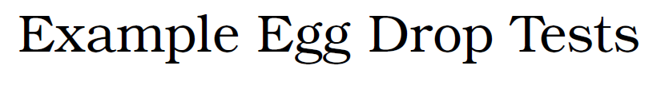
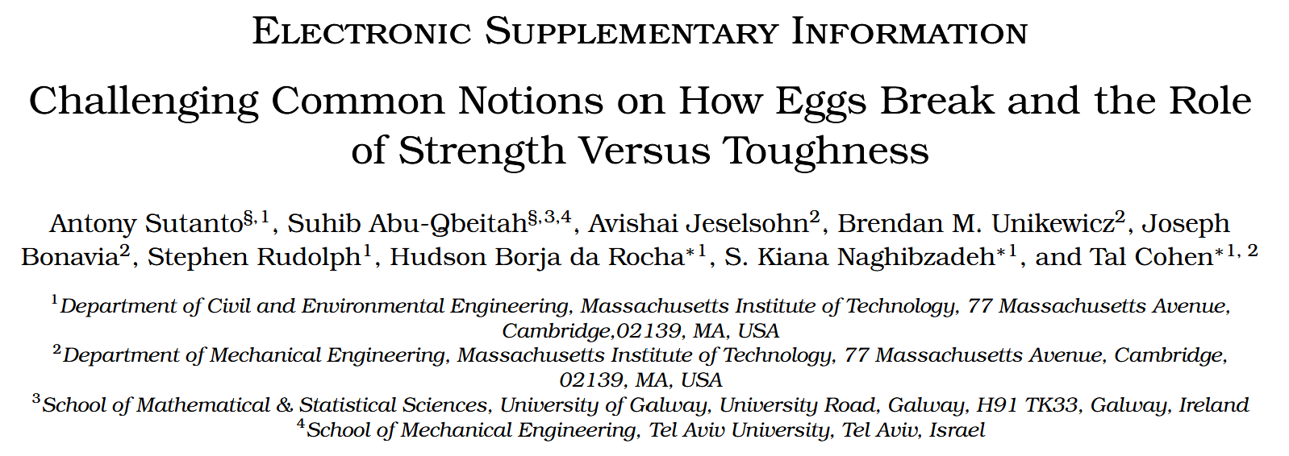

Slide 2


Slide 3
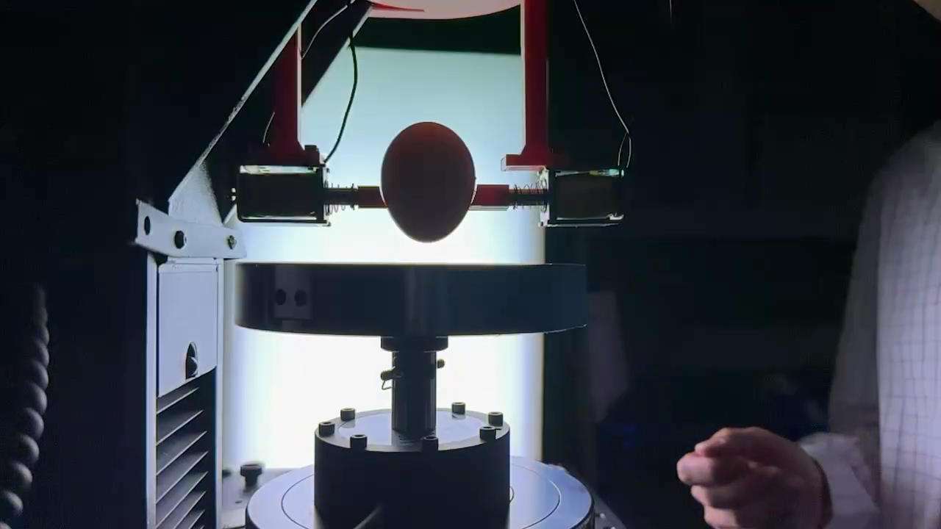
Notes:
sharp end-oriented egg that bounces

Slide 4


Slide 5
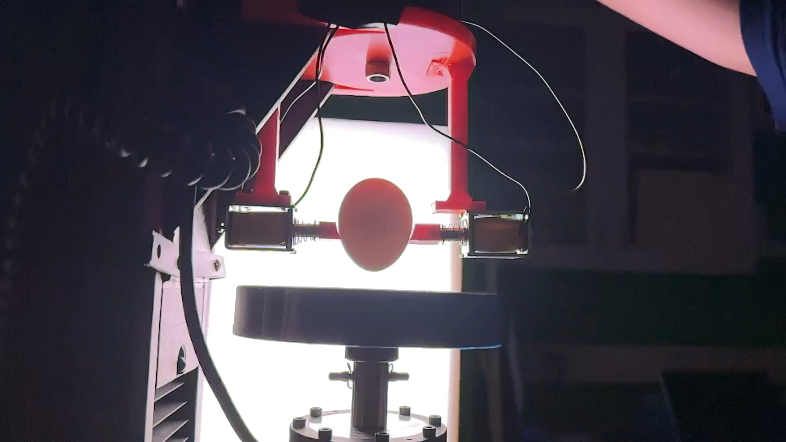
Notes:
Sharp end-oriented egg that cracks

Slide 6


Slide 7
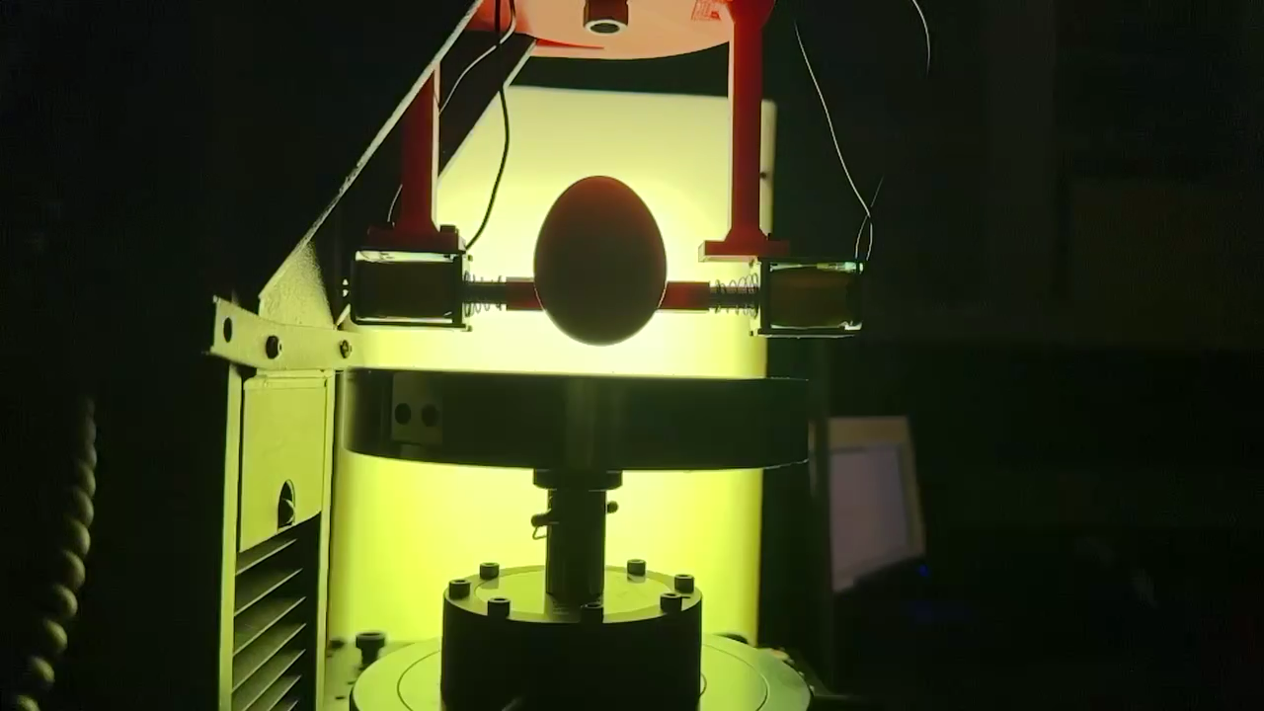
Notes:
Blunt end-oriented egg that bounces

Slide 8


Slide 9
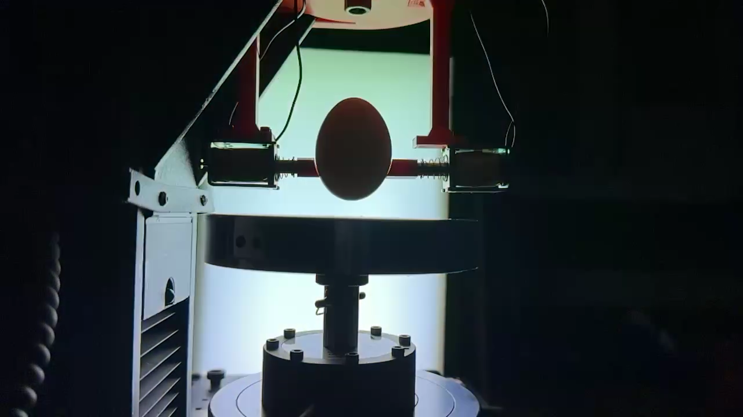
Notes:
Blund end-oriented that cracks

Slide 10
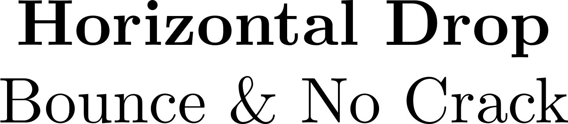

Slide 11
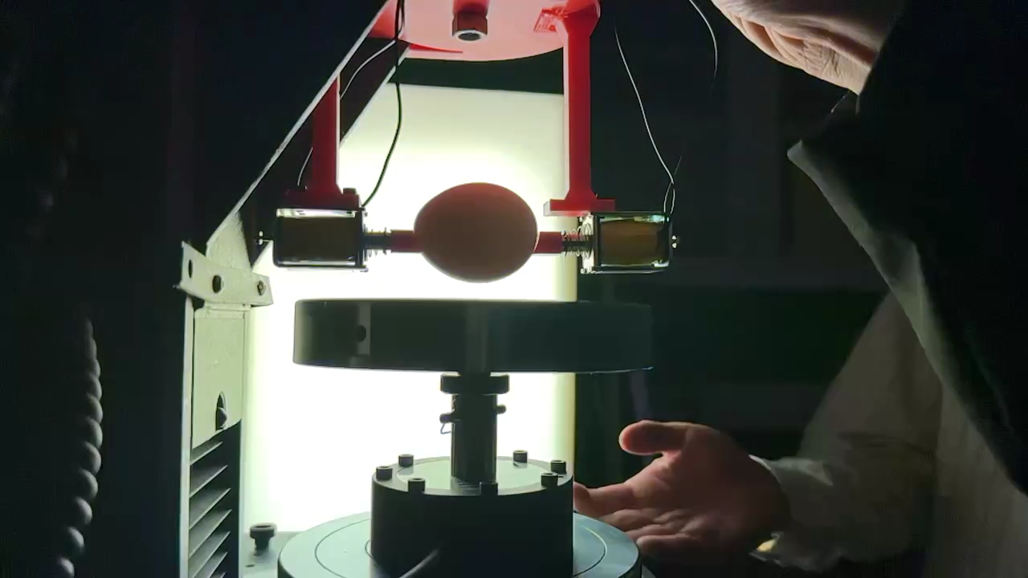
Notes:
Horizontal egg that bounces

Slide 12
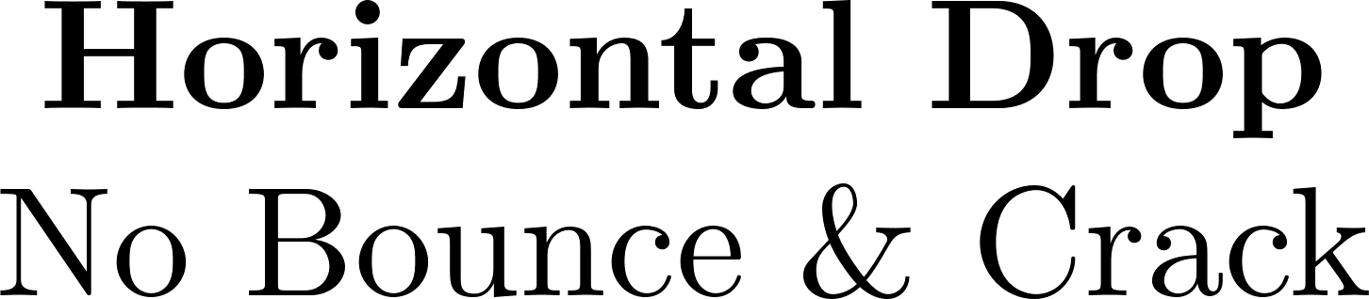

Slide 13
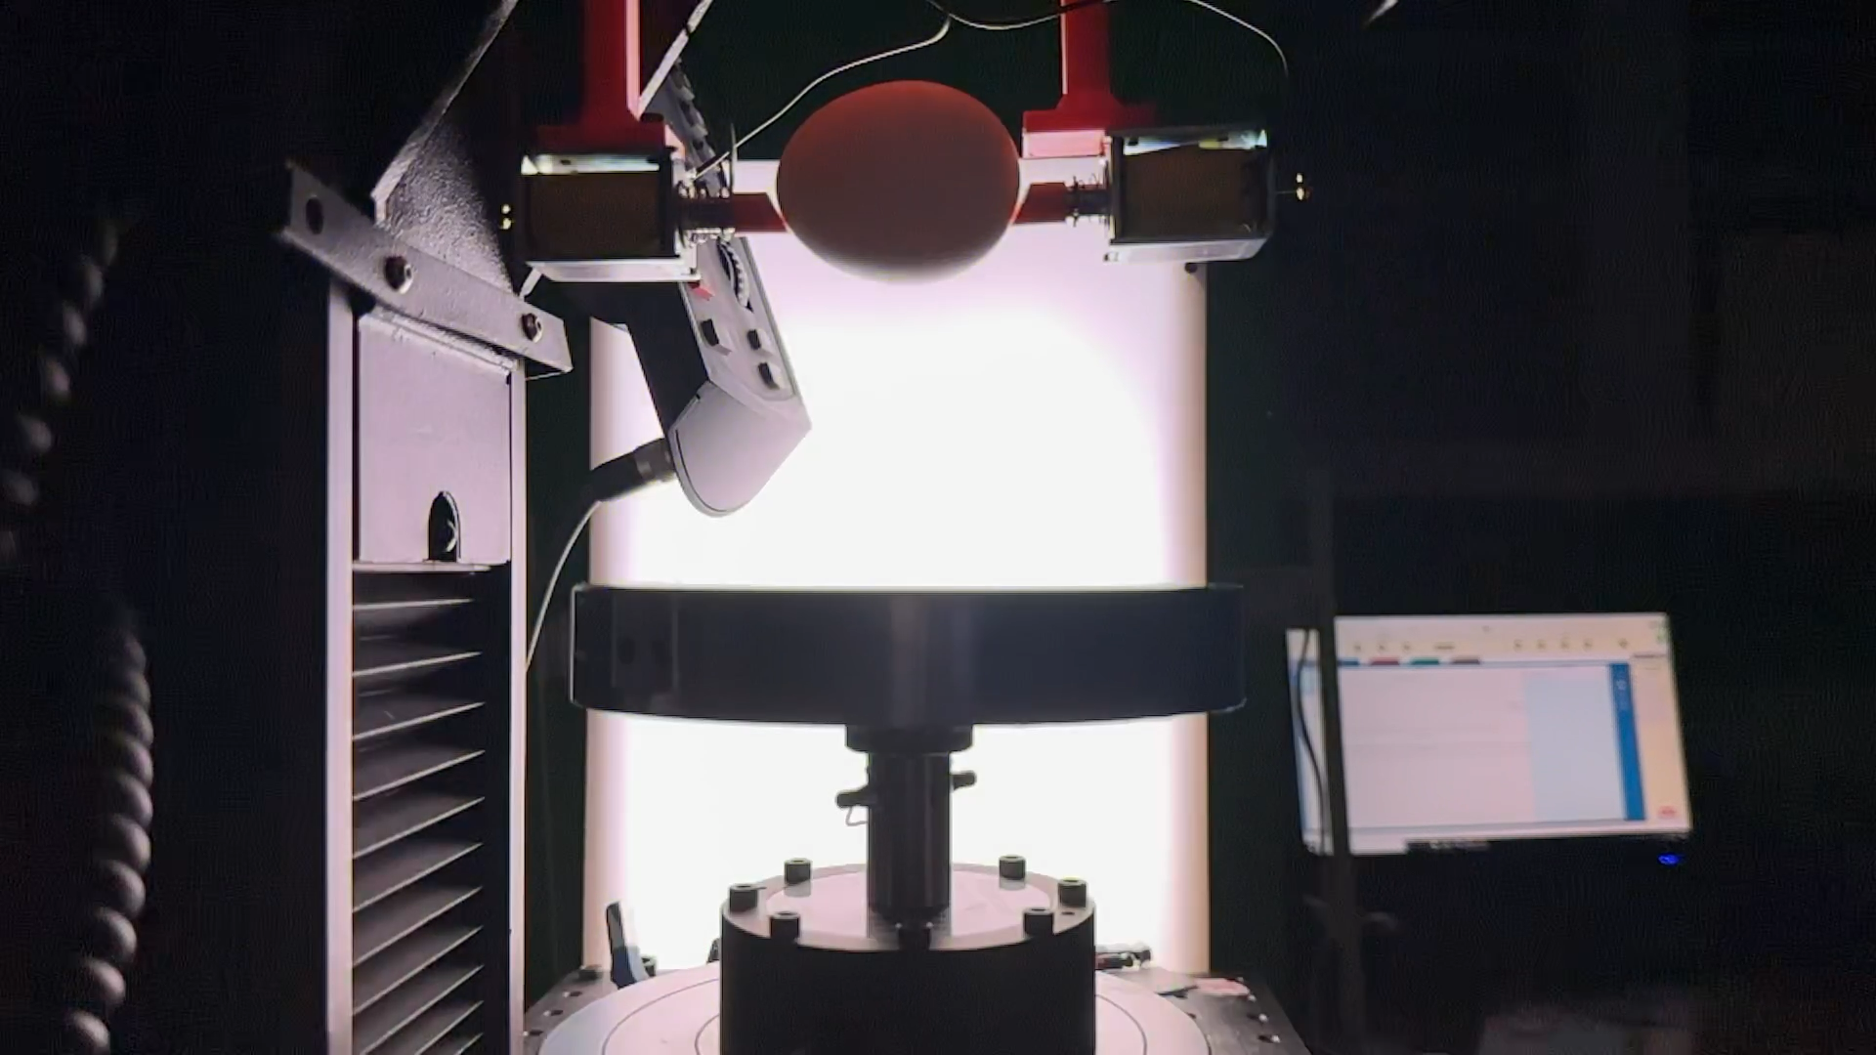
Notes:
Horizontal egg that cracks

